Slide 1
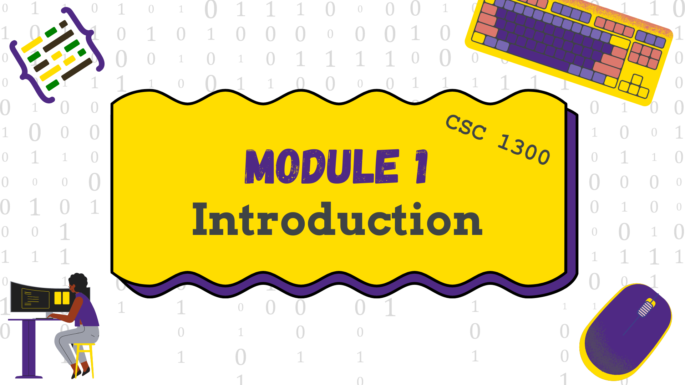
Module 1: Introduction
Notes:
Presentation Slides created by April Crockett, Tennessee Tech University

Slide 2
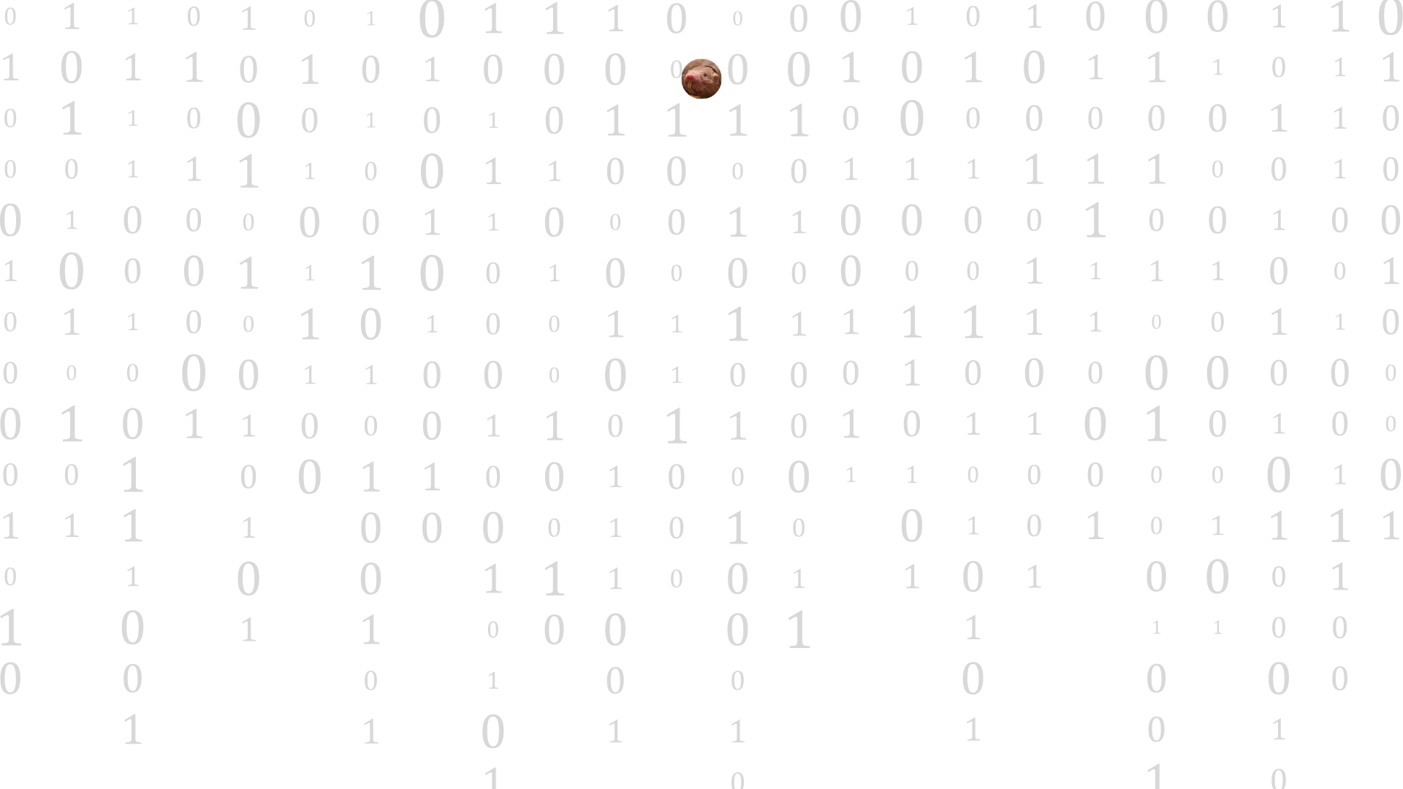
CSC 1300 Course Objectives
Students will be able to…
Develop algorithms using problem-solving techniques.
Write introductory-level procedural programs in C++.
Evaluate, test, and debug computer programs.
Demonstrate acceptable computer programming practices.
Identify and implement algorithmic solutions that use parallel programming.
Identify and implement algorithmic solutions that interact with a remote service.
Recognize when an algorithmic solution can benefit from the user of multiple threads that communicate via events or similar means of interaction

Slide 3
Experience-Based Groups
You get to select which group you want to be in.
You aren’t stuck! You will get two chances during the semester where you can choose to swap to a different group.
Same programming assignments, same quizzes – no matter which group you choose.
How should you choose? (more on this later)
PURPLE GROUP You have no or very little previous programming experience Prefer a gentler, step-by-step pace You will be ready for CSC 1310 by the end of the semester Starting Monday, January 26th, you will be in BRUN 119. | GOLD GROUP You have some programming experience (any language) Faster paced, may go a little more in-depth on some topics. You will be ready for CSC 1310 by the end of the semester Starting Monday, January 26th, you will be in BRUN 228.

Slide 4
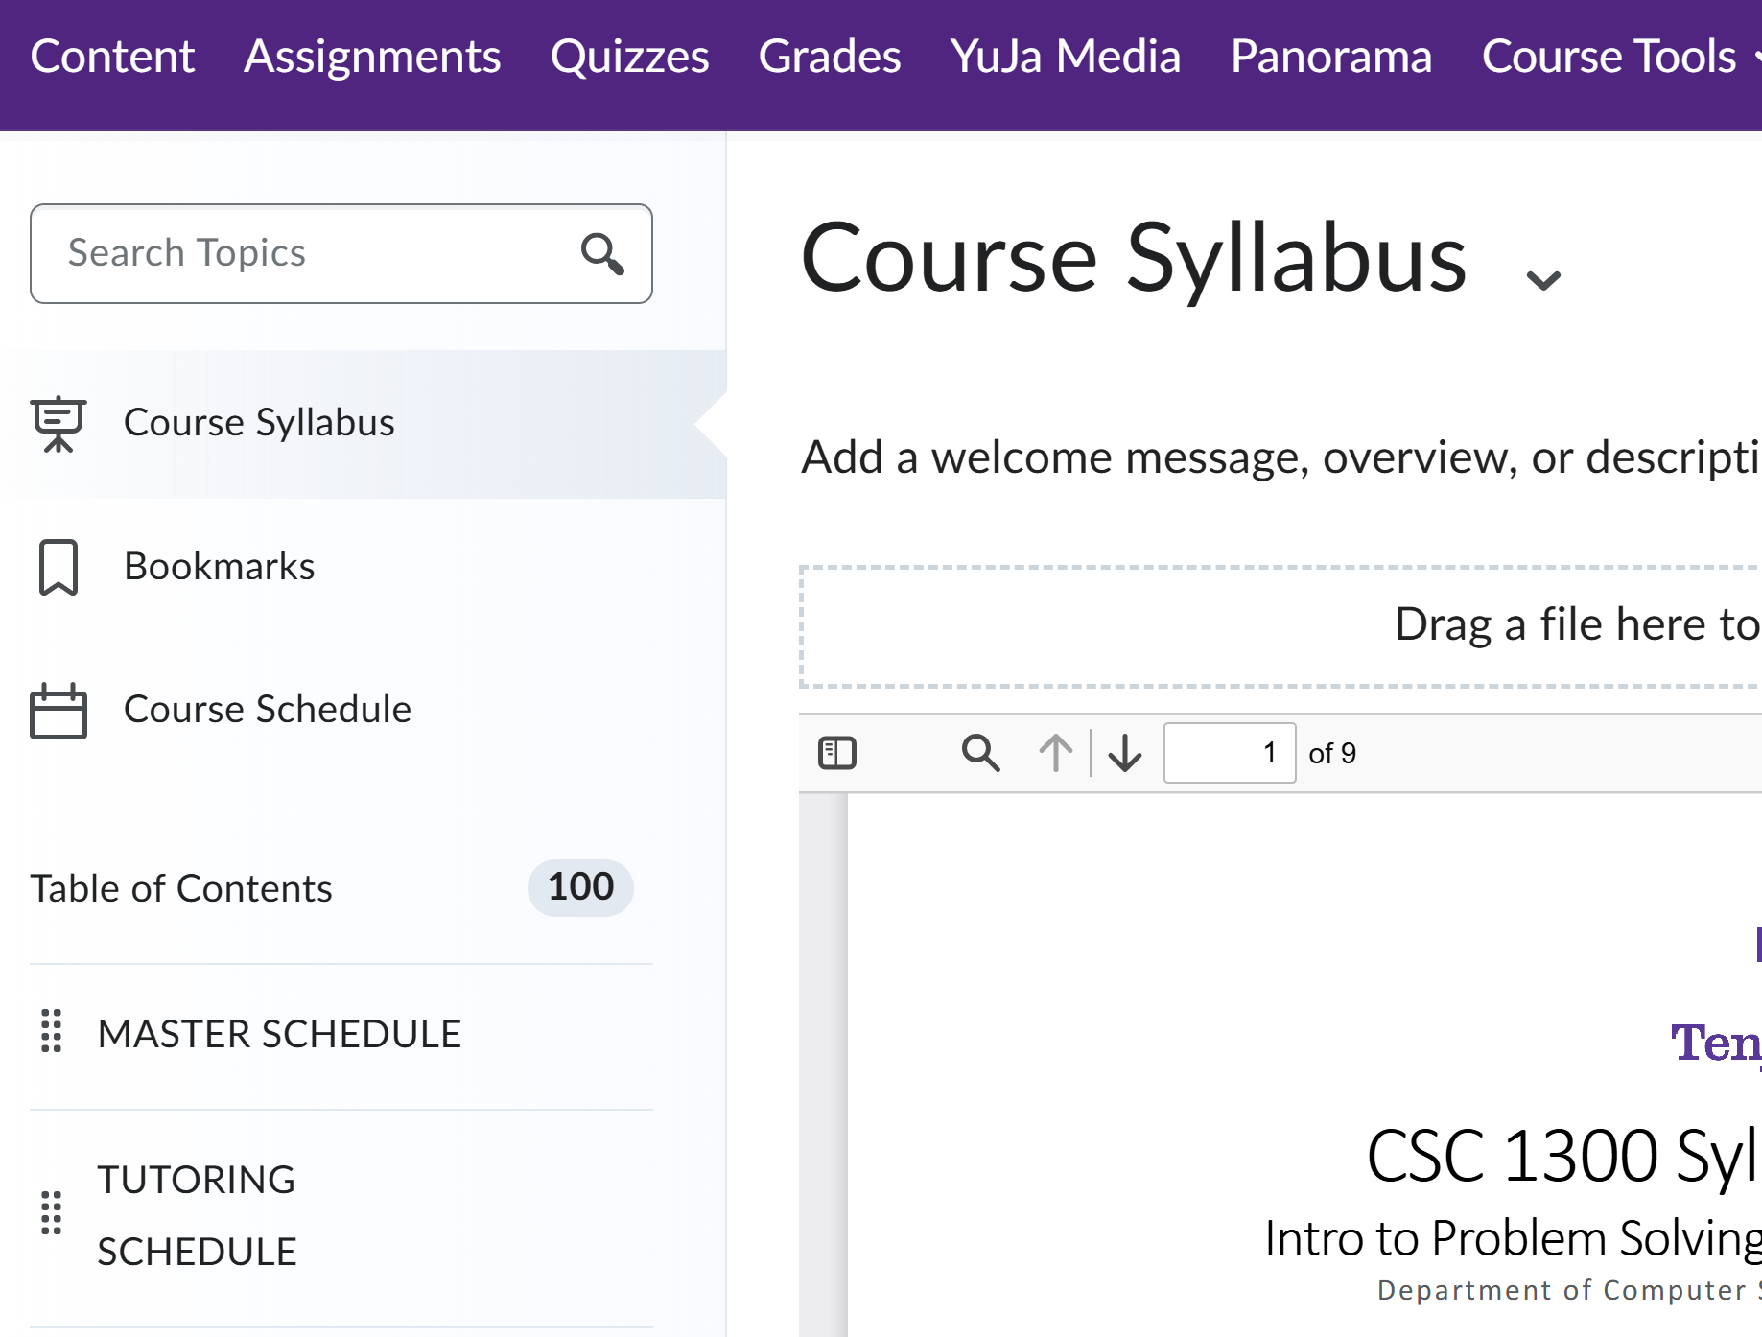

iLearn Demo Link to Tech's eLearn platform Syllabus & Schedule
SYLLABUS
MASTER SCHEDULE
TUTORING SCHEDULE

Slide 5
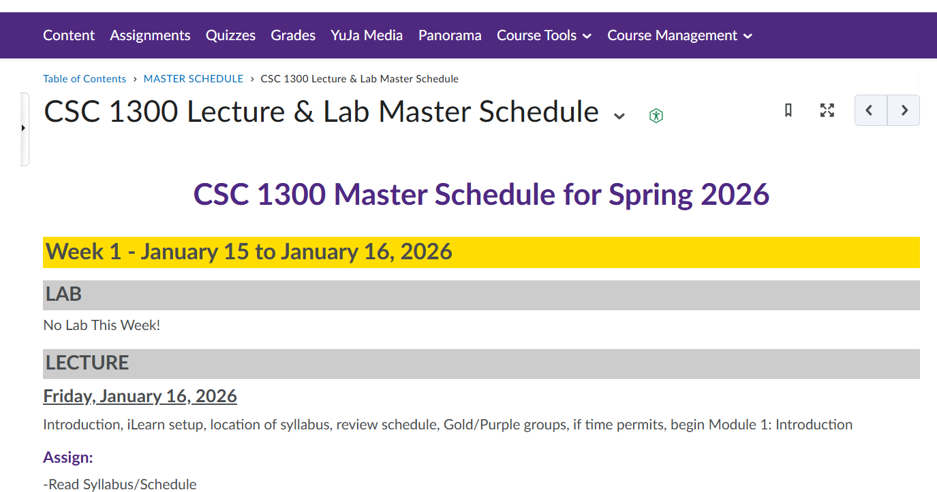
TENTATIVE Master Schedule
The master schedule contains the following:
LABS – when you have them and what they will cover
LECTURE – what is covered, what is assigned, what is due
QUIZZES - when they are, what they cover
PROGRAMS – when assigned & due
HOLIDAYS / NO CLASS
FINAL EXAM

Slide 6
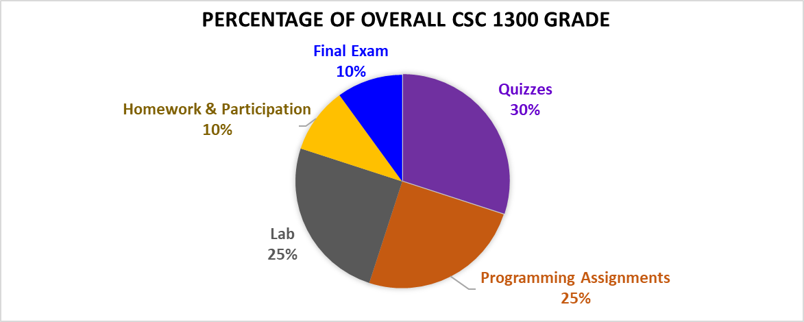
Grade Distribution

Slide 7
Quizzes (30% of Grade)
Quiz Information
You will have several quizzes this semester over the modules covered in class.
All quizzes are online in ilearn using the lockdown browser (or you can opt to take it on paper)
You may not use notes on quizzes.
Questions could be multiple choice, multiple select, true/false, or short answer.
The short answer questions may require you to write code.
Late Quiz Policy (if you miss a quiz)
You must email Ms. Crockett (001 & 002 purple), Ms. Rainey (001 gold), or Mr. Vandergriff (002 gold) within ONE DAY of missing a quiz to be eligible to make up the missed quiz.
You will know which days there is a quiz because quiz dates are in the MASTER SCHEDULE in iLearn.

Slide 8
Programming Assignments (25% of Grade)
You will have FIVE major programming assignments.
You will be given access to the assignment approximately 2 weeks (or more) prior to the due date.
You will not know everything you need to know to complete the assignment the day it is assigned; the point is to work on the assignment throughout the entire 2-3 weeks and do as much as you can in smaller increments (practice incremental programming)
Late Assignment Policy
Lecture programming assignments and lab assignments may be completed/submitted up to 2 days late at a penalty of 10% off per day late.
After 2 days late, the assignment may not be submitted, and the grade will be a zero. Emailed submissions are not accepted.

Slide 9
Lab (25% of Grade)
The first lab class is week of Monday, January 26th through Friday, January 30th
Some weeks you will not have lab. Refer to Master Schedule under Content
You will learn more about lab in your first lab class.
You will have two lab instructors, who are also graders & tutors for the class. (lab schedule next slide)

Slide 10
Academic Integrity Policy (Cheating)
Applies to all assessments in class but especially for Programming & Lab Assignments
You are responsible for reading the entire syllabus including the “Academic Integrity” policy. Saying you didn’t know something wasn’t allowed is not going to count, because you are required to read and understand the syllabus as well as TTU policies.
We are required to charge students with an academic integrity violation if they are sharing code with classmates (when not allowed). Don’t get help from your mom, dad, friend, person off street, uncle, person who took this class prior to this semester, etc. Get help from your professors and from the TAs.
Don’t get charged with an academic integrity violation! It goes on your permanent academic student record, and you could be expelled from TTU.

Slide 11
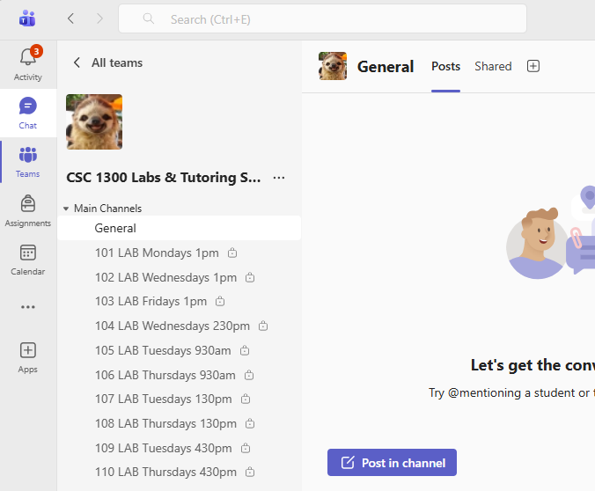
Communication
Communication
Announcements from your instructors will either be in ilearn (on our class home screen) or in our MS Team.
All communication from lab instructors/tutors for this class happens in our MS Team.

Slide 12
More about the Programming Aptitude Quiz (due Wed. Jan 21, 2026)
The score you make on this quiz will not affect your CSC 1300 grade whatsoever. However, you will get a participation grade for completing it, so it is required.
The quiz does not require any computer programming but tests you over logical thinking, problem solving, pattern/syntax recognition, and ability to follow complex procedures.
The score you make on this quiz is an additional measure you can use to help you choose the Gold Group or Purple Group in the selection form due Friday, January 23.
The highest score you can make is 29.
21-29: Above average
14-20: Average
0-14: Below average – this doesn’t mean programming isn’t for you or that you can’t do it – it just means you lack experience, which you will build in this class!

Slide 13
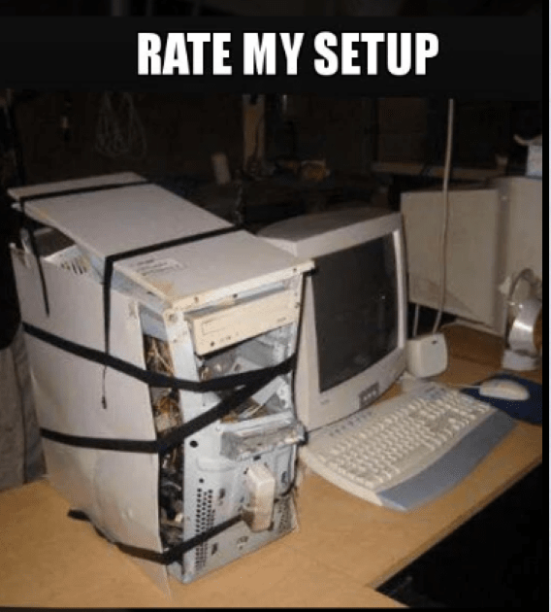
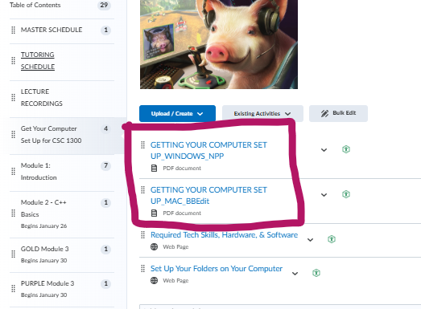
Getting Your Computer Set Up
Follow the directions in the "Getting your Computer Set Up" document that matches your operating system (Windows or Mac)
If you have trouble, it's ok! You can get help from one of the TAs during tutoring hours (begins mid-week next week)

Slide 14
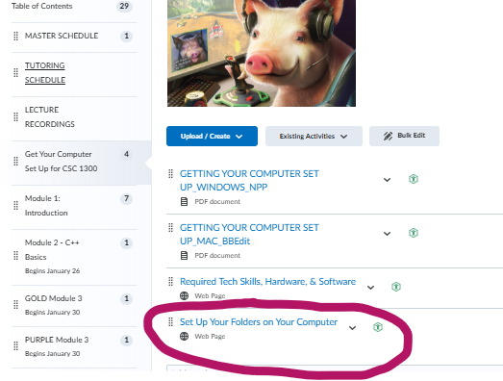
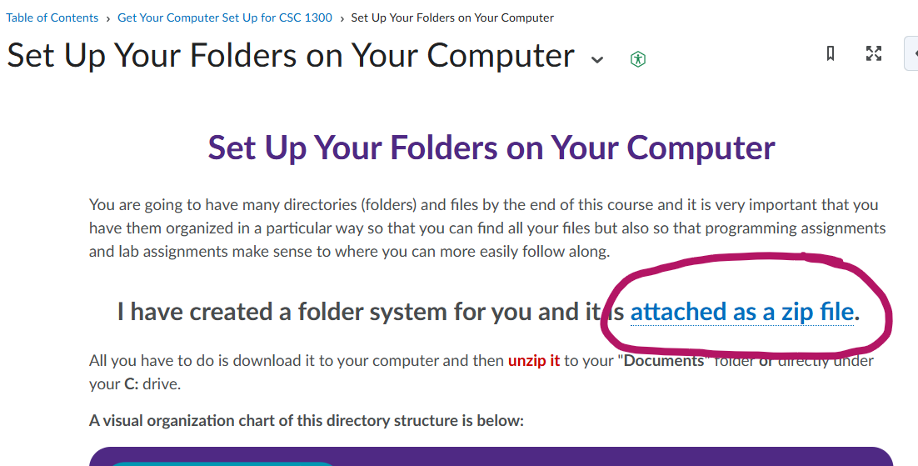
Set Up Your Folders on Your Computer
Follow the directions in the "Set Up Your Folders on Your Computer" page in ilearn under Content and then "Get Your Computer Set Up for CSC 1300"

Slide 15
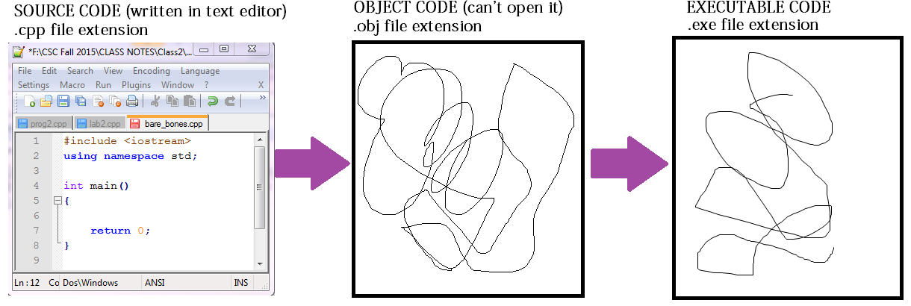
Creating, Compiling, and Running a Program
A compiler is a tool that converts a program into low-level machine instructions (0s and 1s) understood by a computer. C++ is a compiled language – the code is not interpreted until it is compiled.

Slide 16
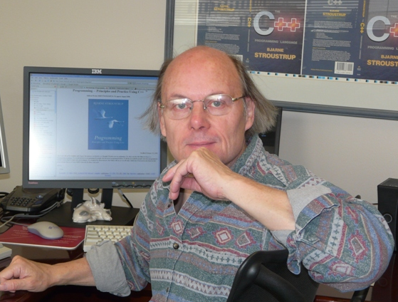
History of C++
C language was written first.
C++ written in 1985 at Bell Laboratories by Bjarne Stroustrup~~~~~~~~~>
What’s up?

Slide 17

Why Do We Use C++ in this course?
The main reason is that C++ allows you to learn programming from the ground up. It gives you a much greater understanding of all the building blocks of programming. Other great reasons to learn C++ include:
Useful in Many Applications – used in Cybersecurity
Fast & Space Efficient
Abundant Library Support
Portable
Syntax is like other Languages (C, C#, Java)

Slide 18
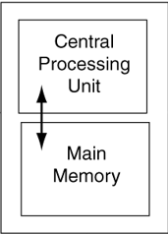

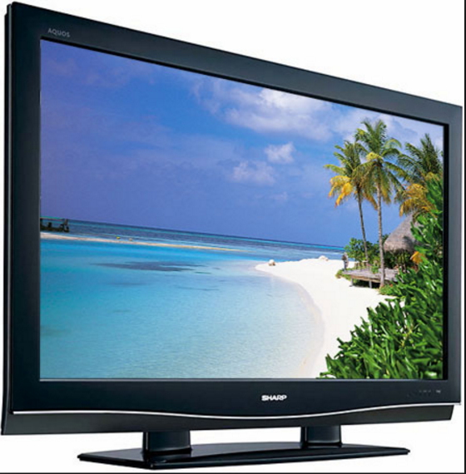
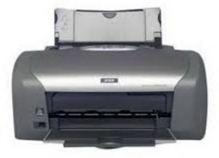
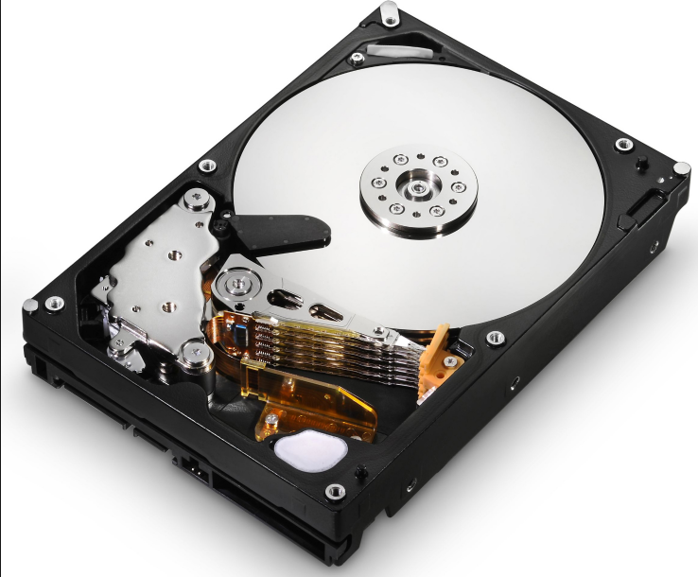
Computer Tour
INPUT DEVICES
OUTPUT DEVICES
RAM
STORAGE / HARD DRIVE

Slide 19
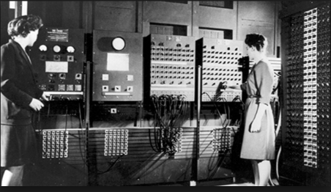
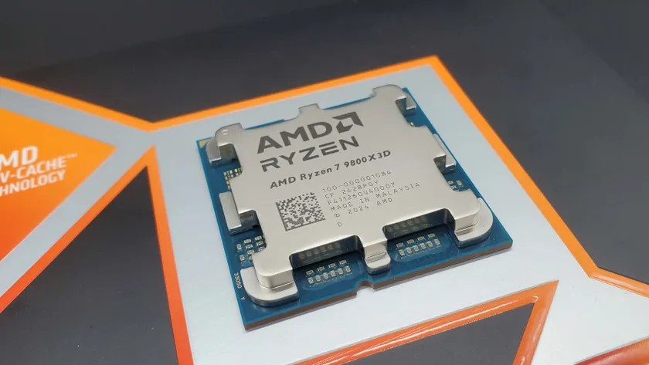
CPU – Central Processing Unit
The CPU is the part of the computer that fetches, decodes, and executes program instructions.
It is the BRAIN of the computer.
A CPU is sometimes called a processor.
CPU named ENIAC – 1945
Size of ENIAC was 1,800 square feet (167 square meters) of floor space
Weight was 30 tons
Consumed 160 kilowatts of electrical power
2026 AMD Ryzen CPU
Size is ~40mm x 40mm (about 1.57 x 1.57 inches)
Weight is ~30-60 grams (1-2 ounces)
Consumes about 15 watts of electrical power

Slide 20
What Makes Up a CPU?
A CPU has two parts.
1. Control Unit
Retrieves and decodes program instructions
Coordinates activities of all other parts of the computer
2. Arithmetic & Logic Unit
Optimized for high-speed numeric calculations
Designed for true/false, yes/no decisions

Slide 21
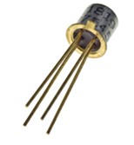
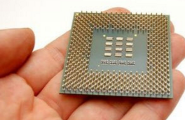
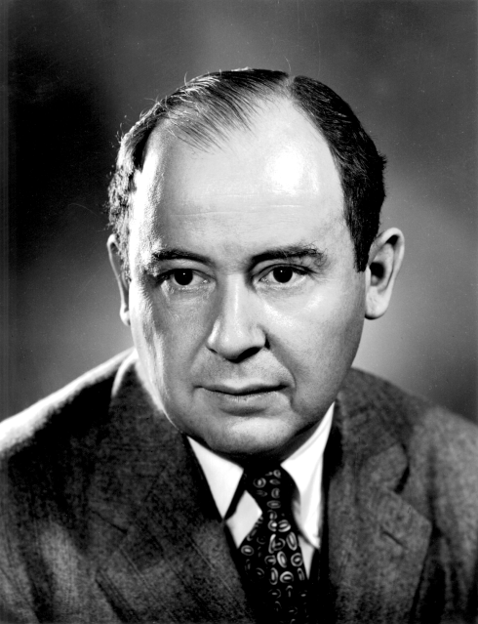
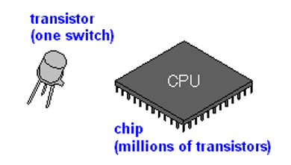
CPU – Central Processing Unit (cont.)
A “core” is the physical processing unit of a CPU.
The CPU is a chip on your motherboard that is made of millions of transistors.
Traditionally the 1945 Von Neumann Architecture, the CPU contained ONE core.
John Von Neumann~~>
(image taken from Wikipedia)

Slide 22
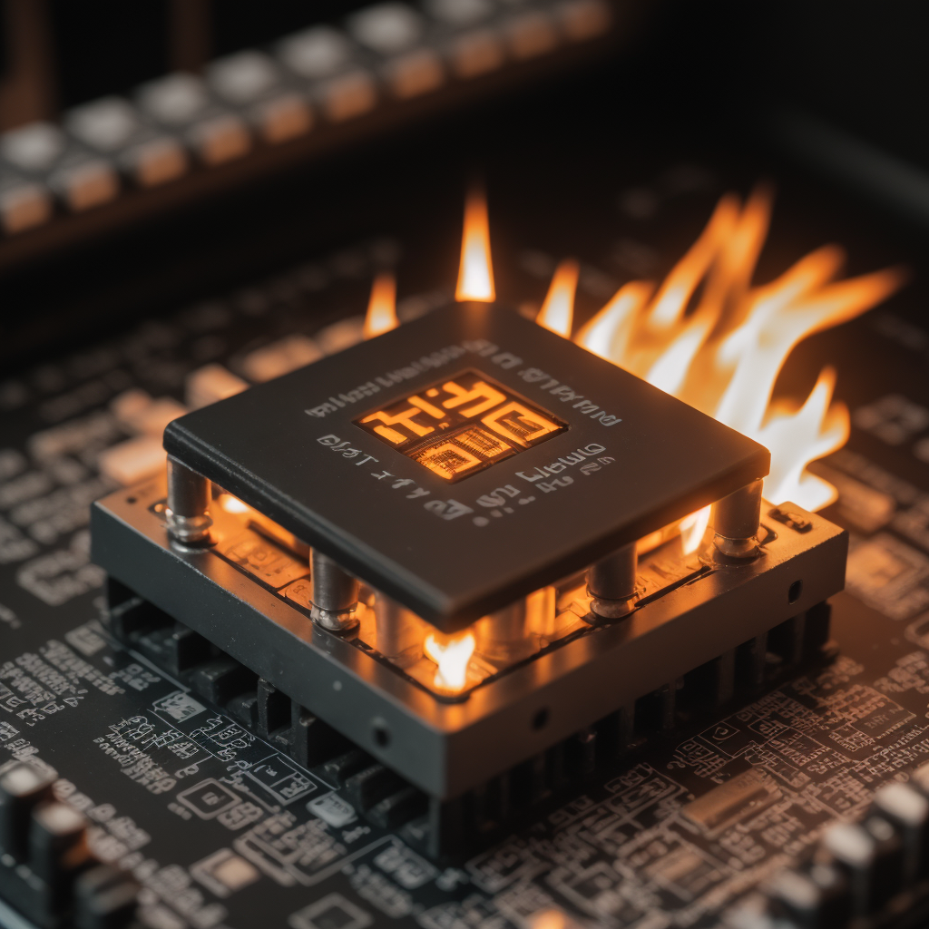


CPU Problem: The POWER WALL
Von Neumann architecture (one CPU) limits how fast the computer can run.
The more transistors on a chip (dense chip), the faster the computer can run, and more power is consumed.
All electrical power consumed is radiated as heat (law of physics)
Dense chips were too hot and beyond the capacity of inexpensive cooling.

Slide 23
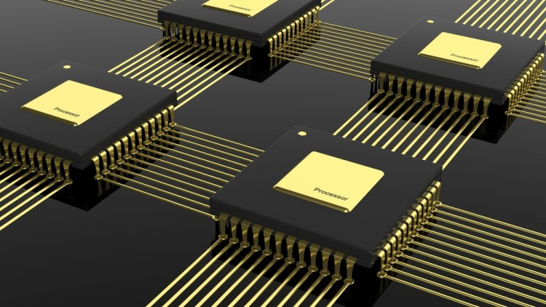
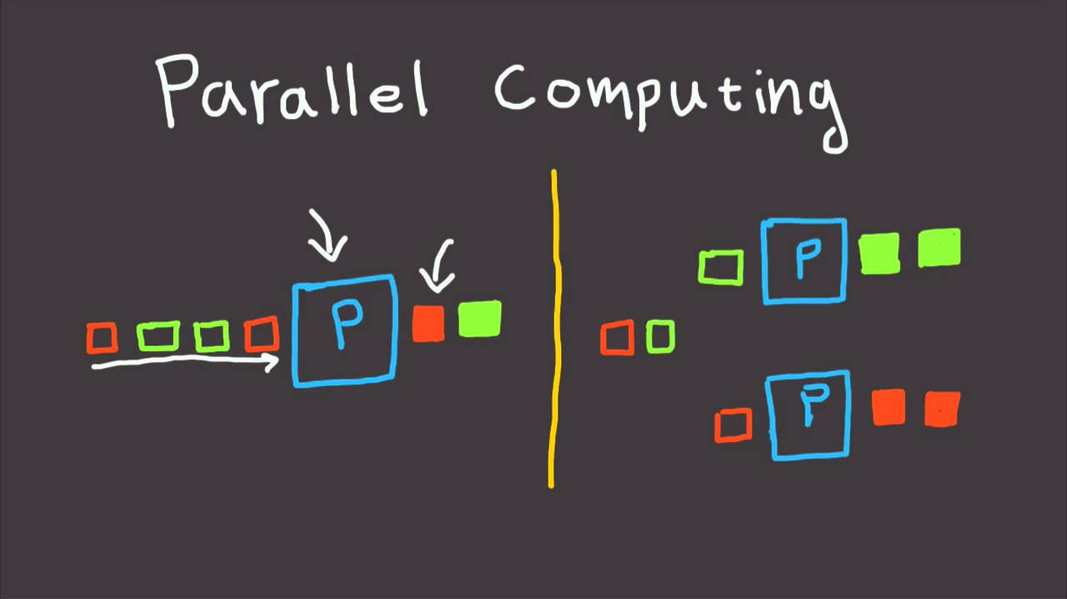
CPU – POWER WALL SOLUTION
The solution to the power wall is multicore processors. (dual-core, quad-core, 8 cores gaming system, 16+ core servers, etc.)
Code can be written so that the instructions are executed in parallel (at the same time) if there are more than one processor.
This is called Parallel Programming or Parallel Computing.

Slide 24
Comparing Sequential vs. Parallel
Sequential
Parallel
Sequential computing is the standard programming model where the computer executes each operation of the program in order, one at a time.
Parallel computing is a computational model that breaks programs into smaller sequential operations and performs those smaller operations in parallel.

Slide 25
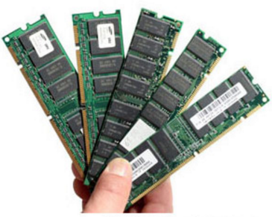
Main memory
Memory is a circuit that can store 0s and 1s in an addressed location.
Memory is divided in equal sections.
Each section is 1 byte = 8 bits = 1 character
A | P | R | I | L
 |  |  |  | F |  |  |  | u
c

Slide 26
Problem Solving
Programming is largely about problem solving.
When given a problem, you shouldn’t just start writing code and hope that you can make it work as you go.
You should first produce a methodical set of steps to solve the problem (an algorithm).
Problem solving is creating a methodical, step-by-step solution to a given task.

Slide 27
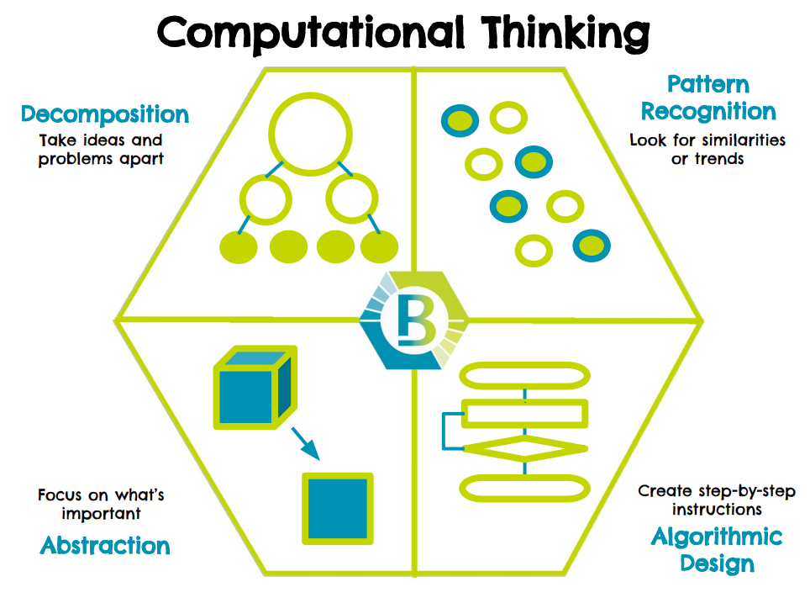
Computational Thinking
Computational thinking is the process of approaching a problem in a systematic manner (step-by-step) and creating and expressing an algorithm that can be carried out by a computer.
Computational thinking has four key thinking processes.
(Image on right from Wake County Schools)

Slide 28
Algorithm
An algorithm is a clear sequence of instructions used to solve a specific problem.
Example Problem: Convert a given number of gallons to number of cups.
Algorithm:
Get number of gallons from user and store in memory.
Multiply the number of gallons by 16 and store in memory.
Print number of cups
Look at the example problem & algorithm on the right.
Can you do the algorithm steps out of order or delete one of the steps and it still work?

Slide 29
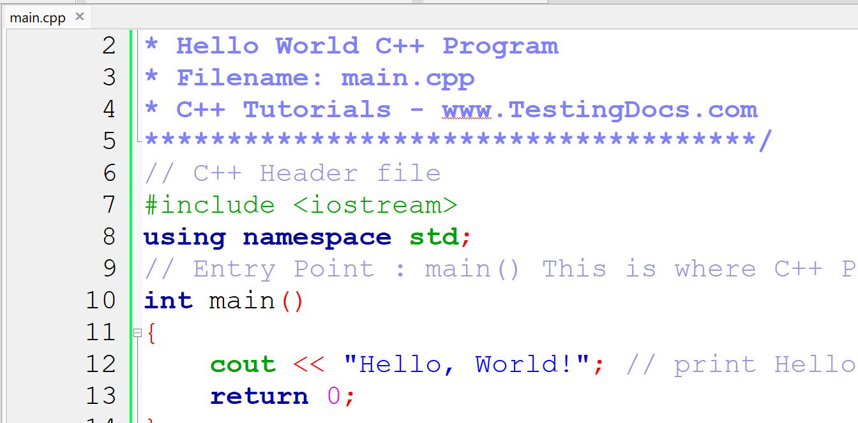
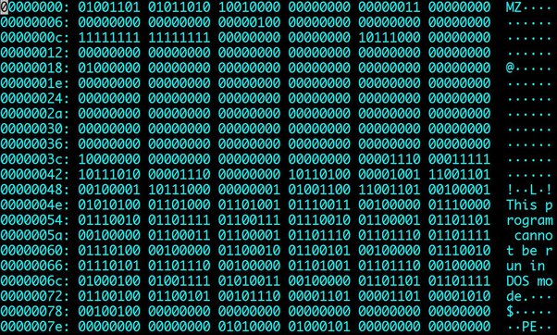
From an Algorithm to a C++ Program
In programming, you write code (programming statements) that follow the instructions in the algorithm to solve a problem.
The code is saved in a source file (.cpp for C++) and then the code is converted to machine language when it is compiled.
Machine language is the elemental language of computers that is read by the CPU. It looks like a very long sequence of zeros and ones.
This runnable code (.exe) or executable file is called a program.
You can also call it an app, application, or software.
Image at top from Testing Docs Website Image at bottom from Quora
This Photo by Unknown Author is licensed under CC BY-NC-ND

Slide 30

End of Module 1

